Slide 1
Understanding Angular and TypeScript
Hardeep Kaur Dhalla
CIS 345

Slide 2
Objectives
Angular in Web applications
TypeScript intro
JavaScript operators

Slide 3
Web Browsing Components
World Wide Web (WWW) A network of interconnected pages of information stored on publicly accessible servers.
Web browsing involves three components:
Web servers
Web browsers
Web pages

Slide 4
The components of a web application

Slide 6
The Client/Server Model
Client/Server can describe a relationship between two computer programs – the "client" and the "server".
Client
requests some type of service (such as a file or database access) from the server.
Server
fulfills the request and transmits the results to the client over a network

Slide 7
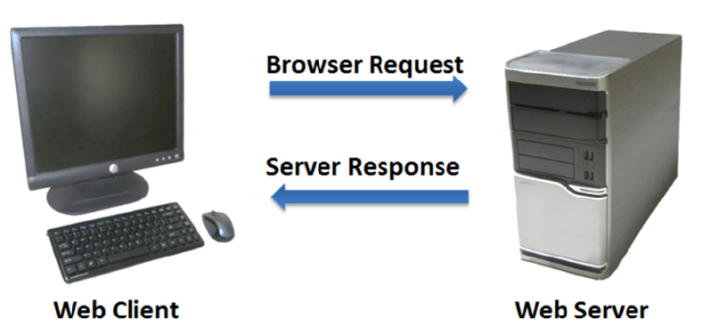
The Client/Server Model
The Internet Client/Server Model
Client: Web Browser
Server: Web Server

Slide 8
Web applications
In general, there are 2 kinds of web applications:
Round-trip – disadvantages of this model?
Single-page
Use Ajax(Asynchronous JavaScript and XML) requests to call server-side code.
Angular works best for single-page applications and in complex round-trip applications.

Slide 9
MVC pattern
Design pattern for a separation of concerns.
HTTP Request
Controller
Model
HTTP Response
View

Slide 10
MVC pattern
Design pattern for a separation of concerns.
HTTP Request
Component
Model
HTTP Response
DOM
Template

Slide 11
MVC
Models
Contains business or domain data.
Domain models might also contain model logic(create, manage, and modify)
Components/Controllers
Helps in setting up template
Contains logic for updating template and models.
View
Markup to create a view for users
Simple logic

Slide 12
RESTful web services
Using Client-server model in Angular apps to avoid tight coupling of logic for domain models.
REST (REpresentational State Transfer) is an architectural style based on transferring representations of resources from a server to a client.
This style underlies the web as a whole and is simpler than SOAP/WSDL for implementing web services.
RESTful services involve a lower overhead than so-called ‘big web services’ and are used by many organizations implementing service-based systems.

Slide 13
Resources
The fundamental element in a RESTful architecture is a resource.
Essentially, a resource is simply a data element such as a catalog, a medical record, or a document.

Slide 14
Resource operations
Create – bring the resource into existence.
Read – return a representation of the resource.
Update – change the value of the resource.
Delete – make the resource inaccessible.

Slide 15
Resource access
When a RESTful approach is used, the data is exposed and is accessed using its URL.
Therefore, the weather data for each place in the database, might be accessed using URLs such as:
http://weather-info-example.net/temperatures/boston http://weather-info-example.net/temperatures/edinburgh
Invokes the GET operation and returns a list of maximum and minimum temperatures.
To request the temperatures for a specific date, a URL query is used:
http://weather-info-example.net/temperatures/edinburgh?date=20140226

Slide 16
What is Angular?
It is easier to develop, test, and maintain rich client-side web applications with Angular.
Written in typescript.
Provides modularity.
Work with HTML5 to extend its capabilities.

Slide 17
What is Angular?
Component based framework – tree model like DOM in HTML
Supports user interactions with amazing handling of data bindings.
Dependency Injection based.
Routing between parent child components for complex applications.

Slide 18
TypeScript
Angular code is written in TypeScript.
TypeScript is open source. It was designed by Anders Hejlsberg (the lead architect of C#) at Microsoft.
TypeScript is a superset of JavaScript so any valid .js file can be renamed to .ts and compiled with other TypeScript files.
It doesn’t run in the browser. The code written in typescript is compiled to JavaScript, which then runs in the browser.

Slide 19
JavaScript
JavaScript only truly provides dynamic typing - running the code to see what happens.
The alternative is to use a static type system to make predictions about what code is expected before it runs.

Slide 20
TypeScript
Static-type checking
supports Object Oriented Programming
Explicit types – parameter type annotations for variables and function signatures
Use of Classes - ECMAScript 2015, also known as ES6, introduced JavaScript Classes.
Use of modules

Slide 21
TypeScript:
TLS (TypeScript Language Service) provides type inference.
TypeScript provides strict null checks.
TypeScript compiler will not allow undefined to be assigned to a variable unless you explicitly declare it to be of nullable type.
For example, let num1 : number = undefined will result in a compile error.

Slide 22
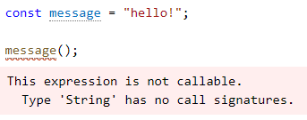
Static type-checking
Static type-checker like TypeScript helps us find bugs before our code runs.
It describes the shapes and behaviors of what our values will be when we run our programs.

Slide 23
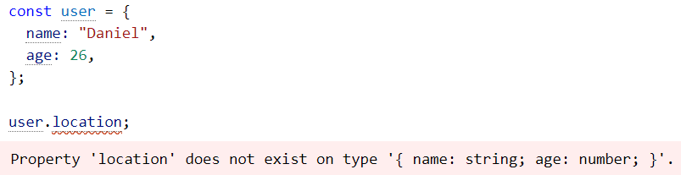
Static type-checking
In TypeScript, the following code produces an error about location not being defined:
Note: JavaScript gives us different behavior and returns the value undefined.

Slide 24
Static type-checking
It also helps in finding bugs introduced by typos, uncalled functions, and logical errors.
An editor that supports TypeScript can deliver “quick fixes” to automatically fix errors, refactoring to easily re-organize code, and useful navigation features for jumping to definitions of a variable, or finding all references to a given variable.

Slide 25

Explicit Types
You have to explicitly write types of variables, parameter names, return type of function etc.

Slide 26
The TypeScript compiler - tsc
Typescript files are saved with .ts extension.
tsc compiles .ts file into a plain JavaScript file with .js extension.
Most TypeScript-specific code gets erased away by the tcs compiler so that you can run it in the browsers.
By default, TypeScript targets ES3, an extremely old version of ECMAScript. Latest is ECMAScript 6.
TypeScript has the ability to rewrite code from newer versions of ECMAScript to older ones such as ECMAScript 3 or ECMAScript 5. This is called downleveling.

Slide 27
Data types
There are 3 primitive data types
string
var fullName: string = ‘John Watson';
number
var married: boolean = true;
boolean
var married: boolean = true;
Arrays – to hold collection of data
number[] or Array<number>
var numbers: number[] = [4, 5, 6];

Slide 28
Data types
Enums – work with numeric values or indexes. Starts with 0. We can use for creating a fixed list of values.
enum Role {Employee, Manager, Admin};
console.log('Roles: ', Role[0], ',', Role[1], 'and', Role[2]);
var role: Role = Role.Employee;
any - any is the default type. Having a variable of type any allows it to receive any kind of value. Avoids type checking.
var something: any = 'as string’;
something = 1;
something = [1, 2, 3];

Slide 29
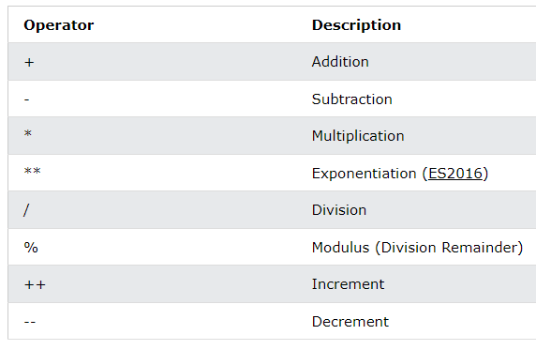
JavaScript Arithmetic Operators

Slide 30
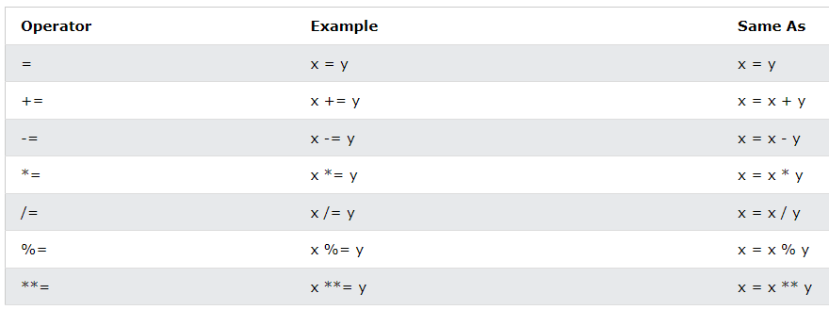
JavaScript Assignment Operators

Slide 31
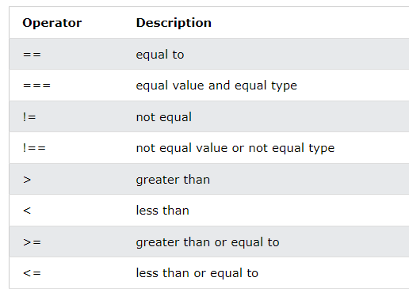
JavaScript Comparison Operators

Slide 32
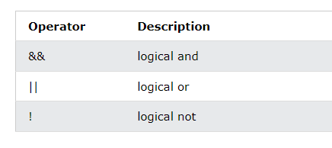
Logical operators

Slide 33
Operators
Ternary operator ?:
+ for concatenation

Slide 34
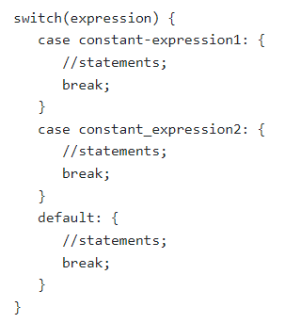
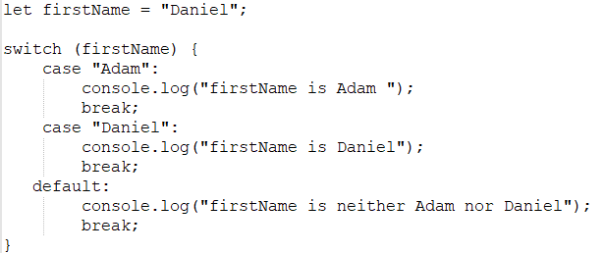
Conditional statements
If
If else
If else if
Switch

